Slide 1
Core Methods in Educational Data Mining
EDUC 6191 Fall 2022

Slide 2
Final project
Let’s take a few minutes to discuss the final project
The end of the semester is creeping up on us

Slide 3
Final project
Anyone who hasn’t found a partner for their project yet: please raise your hand
Please say your name and some topics or areas of application that are of interest to you
Contact each other afterwards or post to Piazza, please

Slide 4
Final project
If you haven’t found project partners by Thanksgiving, send me an email and I’ll see if I can connect people

Slide 5
Presentation slot signup
You can sign up for a presentation slot at this link
https://docs.google.com/spreadsheets/d/1c4E0p1mDplp8UVmtNtXCCtC89Am94AdHuc4hqoHm6S0/edit?usp=sharing

Slide 6
Final project
Any questions?

Slide 7
Wrapping up from last class

Slide 8
DKT-family: work continues
Dozens of recent papers trying to get better results by adjusting the deep learning framework in various ways

Slide 9
Next Frontier for DKT-family: Beyond Correctness
Option Tracing (Ghosh et al., 2021) extends output layer to predict which multiple choice item the student will select

Slide 10
Next Frontier for DKT-family: Beyond Correctness
Open-Ended Knowledge Tracing (Liu et al., 2022) integrates KT with
A GPT-2 model fine-tuned on 2.1 million Java code exercises and written descriptions of them
In order to generate predicted student code which makes predicted specific errors

Slide 11
Questions? Comments?

Slide 12
Discussion (if there’s time)
What additional information could be useful to add as inputs?
How could we go further in what we predict?

Slide 13
Final questions on DKT-family knowledge tracing?

Slide 14
Knowledge Structure Discovery

Slide 15
Q-Matrix (Tatsuoka, 1983; Barnes, 2005)
 | Skill1 | Skill2 | Skill3 | Skill4
Item1 | 1 | 0 | 0 | 0
Item2 | 1 | 1 | 0 | 0
Item3 | 1 | 0 | 1 | 0
Item4 | 0 | 0 | 0 | 1
Item5 | 0 | 0 | 1 | 1
Item6 | 0 | 1 | 0 | 0

Slide 16
Example
 | Add | Subtract | Multiply | Divide
7 + 3 + 2 | 1 | 0 | 0 | 0
7 + 3 - 2 | 1 | 1 | 0 | 0
(7 + 3) * 2 | 1 | 0 | 1 | 0
7 / 3 / 2 | 0 | 0 | 0 | 1
7 * 3 / 2 | 0 | 0 | 1 | 1
7 - 3 - 2 | 0 | 1 | 0 | 0

Slide 17
Partial Order Knowledge Spaces (Desmarais et al., 1996, 2006)
Postulate relationships between items
Mastery of one item is prerequisite to mastery of another item

Slide 18
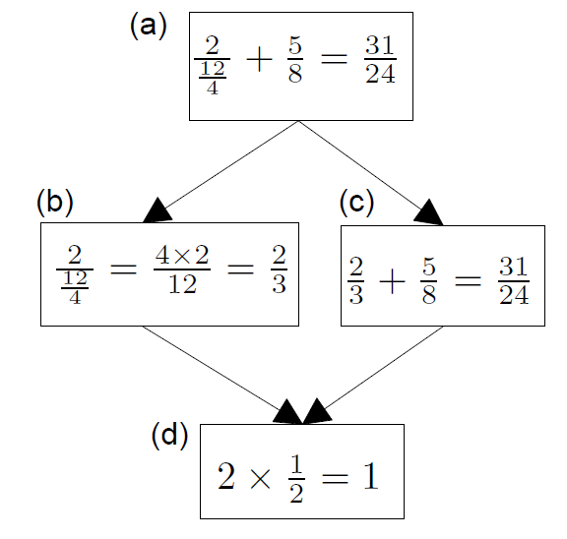
Example (Desmarais et al., 2006)
B does not inform us about C
If student succeeds at C, they will succeed at D;
D is prerequisite to C

Slide 19
Extension to skills
POKS can be extended rather easily to use skills (interchangeable items) rather than items

Slide 20
Bayesian Networks
Less restricted set of models that also infer relationships between skills and items, and between skills
Can infer more complicated relationships between material than the very restricted set of relationships modeled in POKS
Can infer {skill-skill, item-item, skill-item} relationships at the same time
Can integrate very diverse types of information
That extra flexibility can lead to over-fitting (cf. Desmarais et al., 2006)

Slide 21
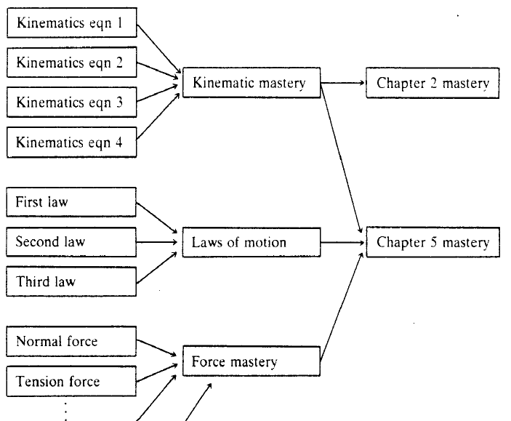
Martin & VanLehn (1995)

Slide 22
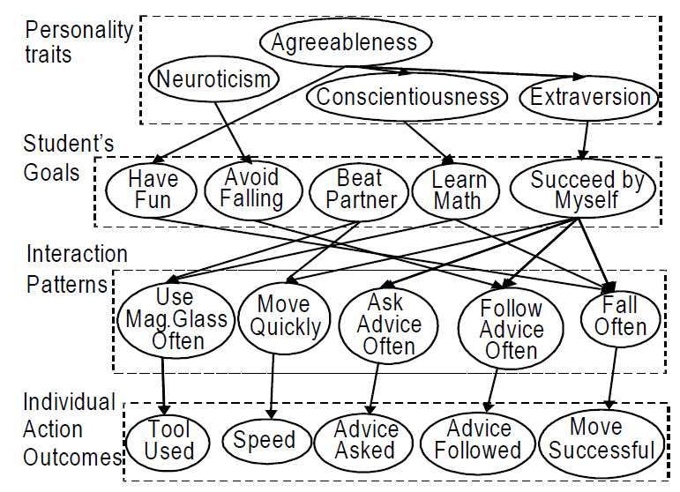
Conati et al., 2009

Slide 23
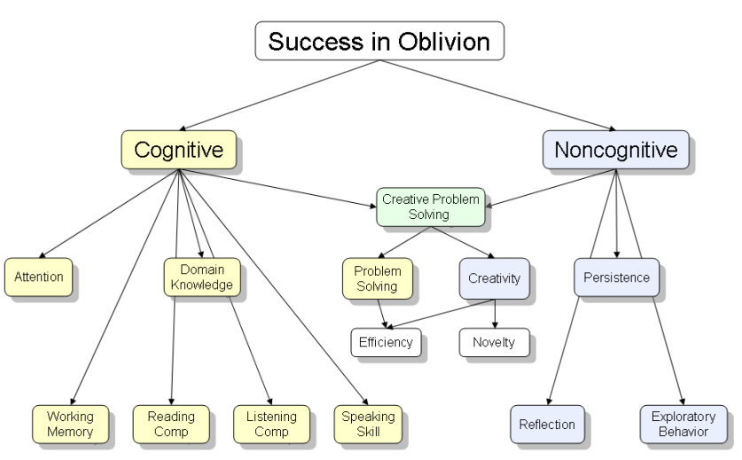
Shute et al., 2009

Slide 24
Comments? Questions?

Slide 25
What are the relative benefits of using a q-matrix versus a knowledge space?

Slide 26
What are the consequences of getting a knowledge mapping wrong?

Slide 27
Knowledge Structure Discovery
Why would someone want to discover the knowledge structure?

Slide 28
Automated model discovery (from scratch)
What are some ways to do this?

Slide 29
Automated model discovery (from scratch)
What are some ways to do this?
PCA/Factor Analysis
Barnes’s method
NNMF
DKVMN/KQN
What situation does each apply in?

Slide 30
Automated model discovery (from scratch)
What are the advantages and disadvantages of those approaches?

Slide 31
Hand development and refinement
What are the advantages and disadvantages of this type of approach?

Slide 32
Hybrid approach: Learning Factors Analysis
Does anyone remember this from the lecture?

Slide 33
Hybrid approach: LFA
What are the advantages and disadvantages?

Slide 34
What does a spike in a learning curve mean?

Slide 36
What are the trade-offs
Between Knowledge Spaces
And Bayes Nets
?

Slide 37
Other questions or comments?

Slide 38
Upcoming Classes
November 22 SPECIAL DAY
ALL VIRTUAL CLASS
NO RYAN OFFICE HOURS
Cluster Analysis
Creative: Knowledge Structure due
December 1
IN-PERSON CLASS: GUEST LECTURER STEFAN SLATER
NO RYAN OFFICE HOURS
Correlation Mining
Basic: Clustering due
December 8
Reinforcement Learning
Basic: Correlation Mining due
December 15
Final Project Presentations, 11a-12p AND 3p-450p

Slide 39
The End

